Slide 1



Creating Our Robot Overlords
Autonomous Drone Development with Java and IoT
#DevNexusDrone
James Weaver / Mark Heckler
Java Ambassador / Software Engineer
Oracle
Sean Phillips
Software Engineer
Ai Solutions
Copyright © 2014, Oracle and/or its affiliates. All rights reserved. |

Slide 2
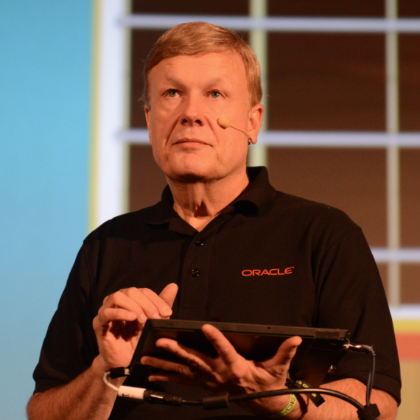
About the presenter
#DevNexusDrone
James Weaver
Java Technology Ambassador
Oracle Corporation
Twitter: @JavaFXpert
Email: james.weaver@oracle.com

Slide 3
Program Agenda
#DevNexusDrone
1
Achieving autonomous flight
Raspberry Pi for brains
Anatomy of a quadcopter
Leveraging IoT concepts and tools
3D flight simulation
Next step: Self-aware drone (implementing a control loop)
2
3
4
5
6

Slide 4

Achieving Autonomous Flight!
First things first
Choosing a drone
Finding or writing a foundational library
Determining level of autonomous ops
Equipment list
Drone
Brain
Power
Making it work
And this is where the story gets really interesting
#DevNexusDrone

Slide 5
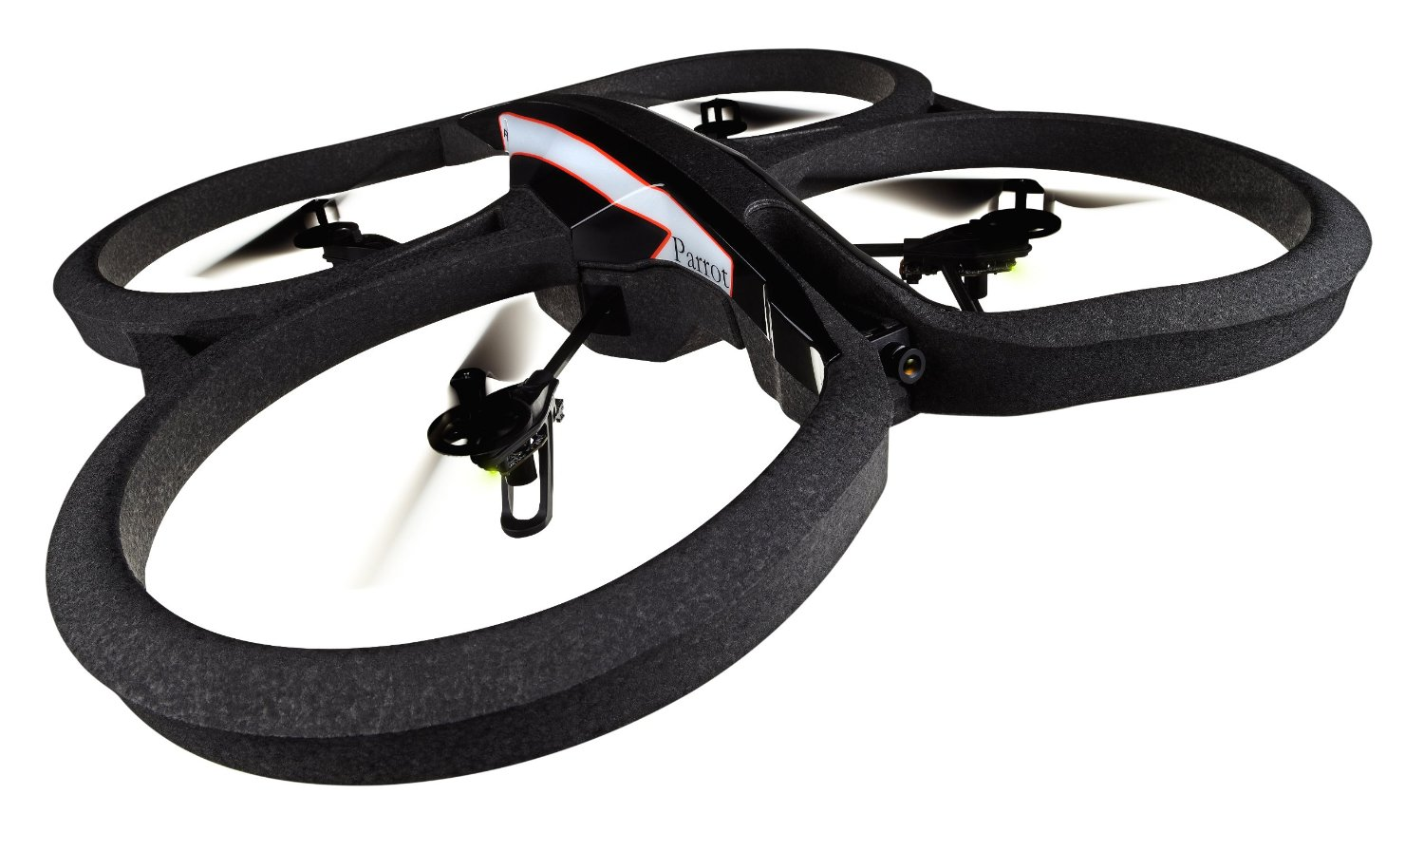
Achieving Autonomous Flight! Making the Tough Choices
Which drone?
Published API
Community
Price of equipment
Parrot AR.Drone 2.0 (Parrot.com)
Which library?
Capability
Reliability
Responsibility
Parrots On Java/Parroteer (ParrotsOnJava.com)
#DevNexusDrone

Slide 6
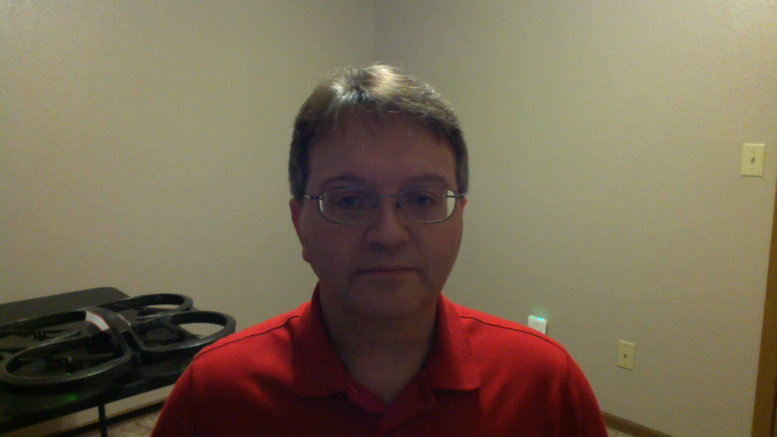
Message from co-presenter Mark Heckler @MkHeck
#DevNexusDrone

Slide 7

Achieving Autonomous Flight! Assembling the Pieces
Equipment list
Parrot AR.Drone 2.0
Brain
Raspberry Pi Model B with case
Two (2) Edimax EW-7811un wifi adapters
16G Class 10 SD card
Power
dodocool 2600 mAh mini power bank/charger
Cablejive microStubz extra short USB to micro USB cable
Anything else?
Duct/gaffer’s tape! (Just kidding, we used Velcro)
#DevNexusDrone

Slide 8
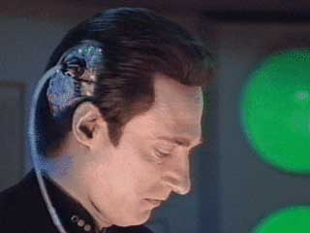
Achieving Autonomous Flight! Configuring the Positronic Brain
Central piece of the puzzle
Configure one wifi adapter to connect as a client to the drone
Configure other with Pi running
Wireless Access Point
DHCP server
More details in a bit…
#DevNexusDrone

Slide 9
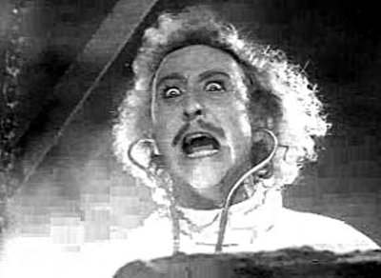
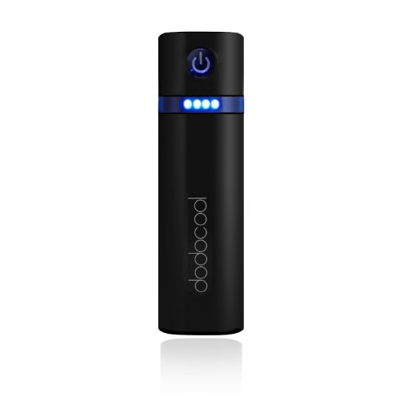
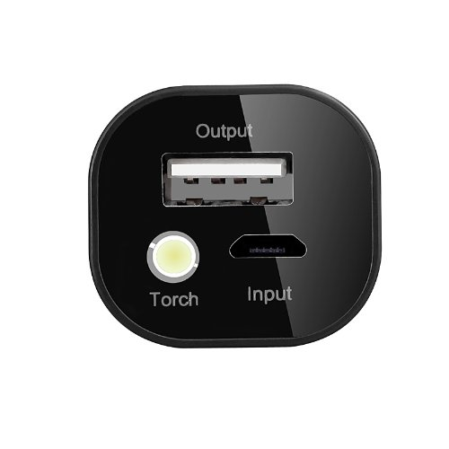
Achieving Autonomous Flight! Powering the Positronic Brain
No straightforward means of powering other devices from drone
How to fix?
Add a power source!
#DevNexusDrone

Slide 10
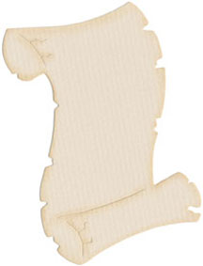
Raspberry Pi for Brains Bill of Materials
One (1) Raspberry Pi Model B
One (1) Raspberry Pi case (smaller/lighter is better)
One (1) SD card, Class 10, minimum 8G
Two (2) Edimax EW-7811un wifi adapters
One (1) Raspberry Pi power adapter (for initial configuration steps)
One (1) portable USB mobile phone charger
One (1) ethernet cable (for initial configuration steps)
Parts list with links in appendix
#DevNexusDrone

Slide 11
Raspberry Pi for Brains Configuring the Software Stack
Raspbian, typical configuration
Configure as Wireless Access Point (hostapd, DHCP server) – 1st adapter
Configure to connect to drone, get IP address (DHCP client) – 2nd adapter
Tweak ifplugd to maintain two concurrent connections
Startup script, timing (initiating network connections, DHCP server a bit fiddly initially)
Full documentation available at:
https://bitbucket.org/autonomous4j/autonomous4jga/wiki/PiConfiguration
#DevNexusDrone

Slide 12

Achieving Autonomous Flight! Making it Work
Didn’t anticipate many issues
In hindsight, that was just silly
Firmware challenges
API challenges
Equipment challenges
Sensing a pattern?
#DevNexusDrone

Slide 13

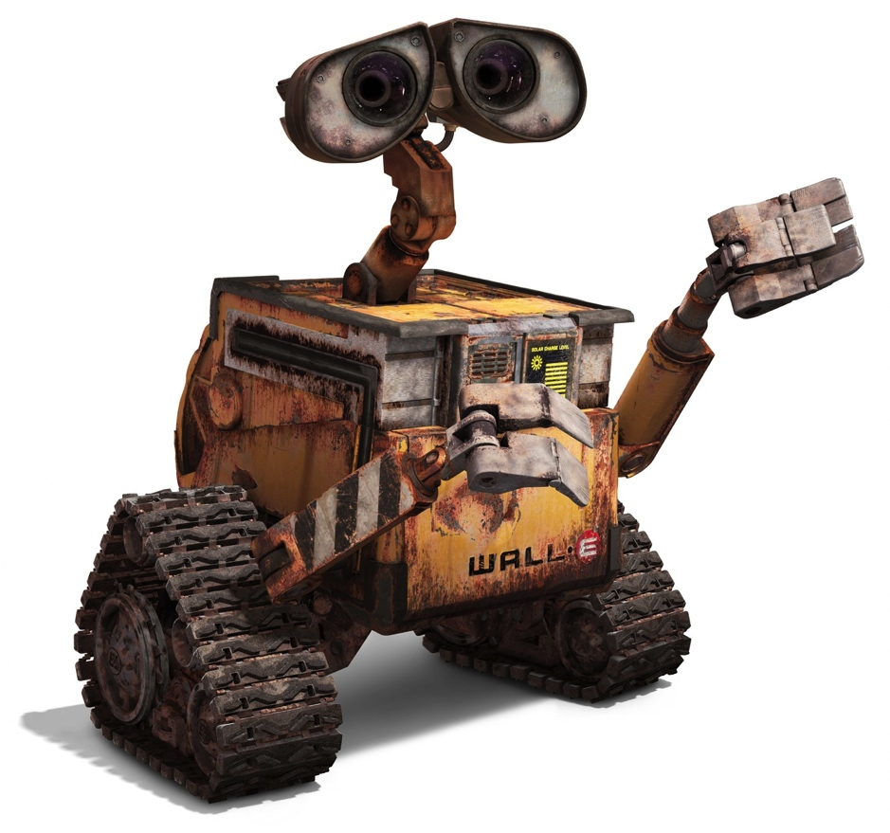
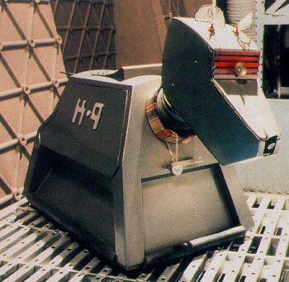
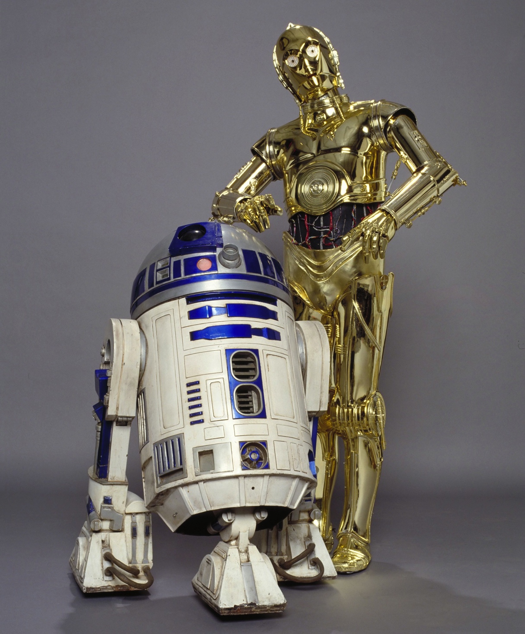

Achieving Autonomous Flight! (Unrealistic) Expectations
#DevNexusDrone

Slide 14


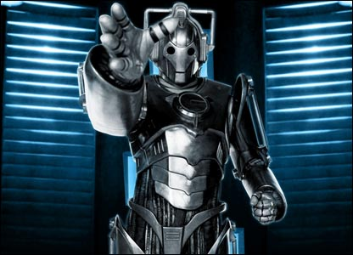
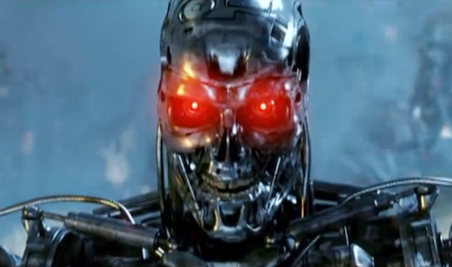
Achieving Autonomous Flight! In some ways, it’s more like…
#DevNexusDrone

Slide 15

Achieving Autonomous Flight! With a bit of this thrown in for good measure…
#DevNexusDrone

Slide 16

The AR Drone flies better without the extra weight ...
#DevNexusDrone

Slide 17
Anatomy of a Quadcopter (AR Drone 2.0)
Four spinning blades of doom (!)
brushless motors
motor controllers
Lithium polymer battery, 1000mAh
Onboard wireless access point
Indoor shell / outdoor shell
#DevNexusDrone

Slide 18
Anatomy of a Quadcopter (AR Drone 2.0 sensors)
Inertial Measurement Unit:
gyroscope (3 degrees of freedom)
accelerometer (3 degrees of freedom)
magnetometer (3 degrees of freedom)
Ultrasound height sensor
Pressure sensor (measures high flight)
Front camera (720p, 30fps)
Downward camera (360p, 30fps visual odometry sensor)
#DevNexusDrone

Slide 19
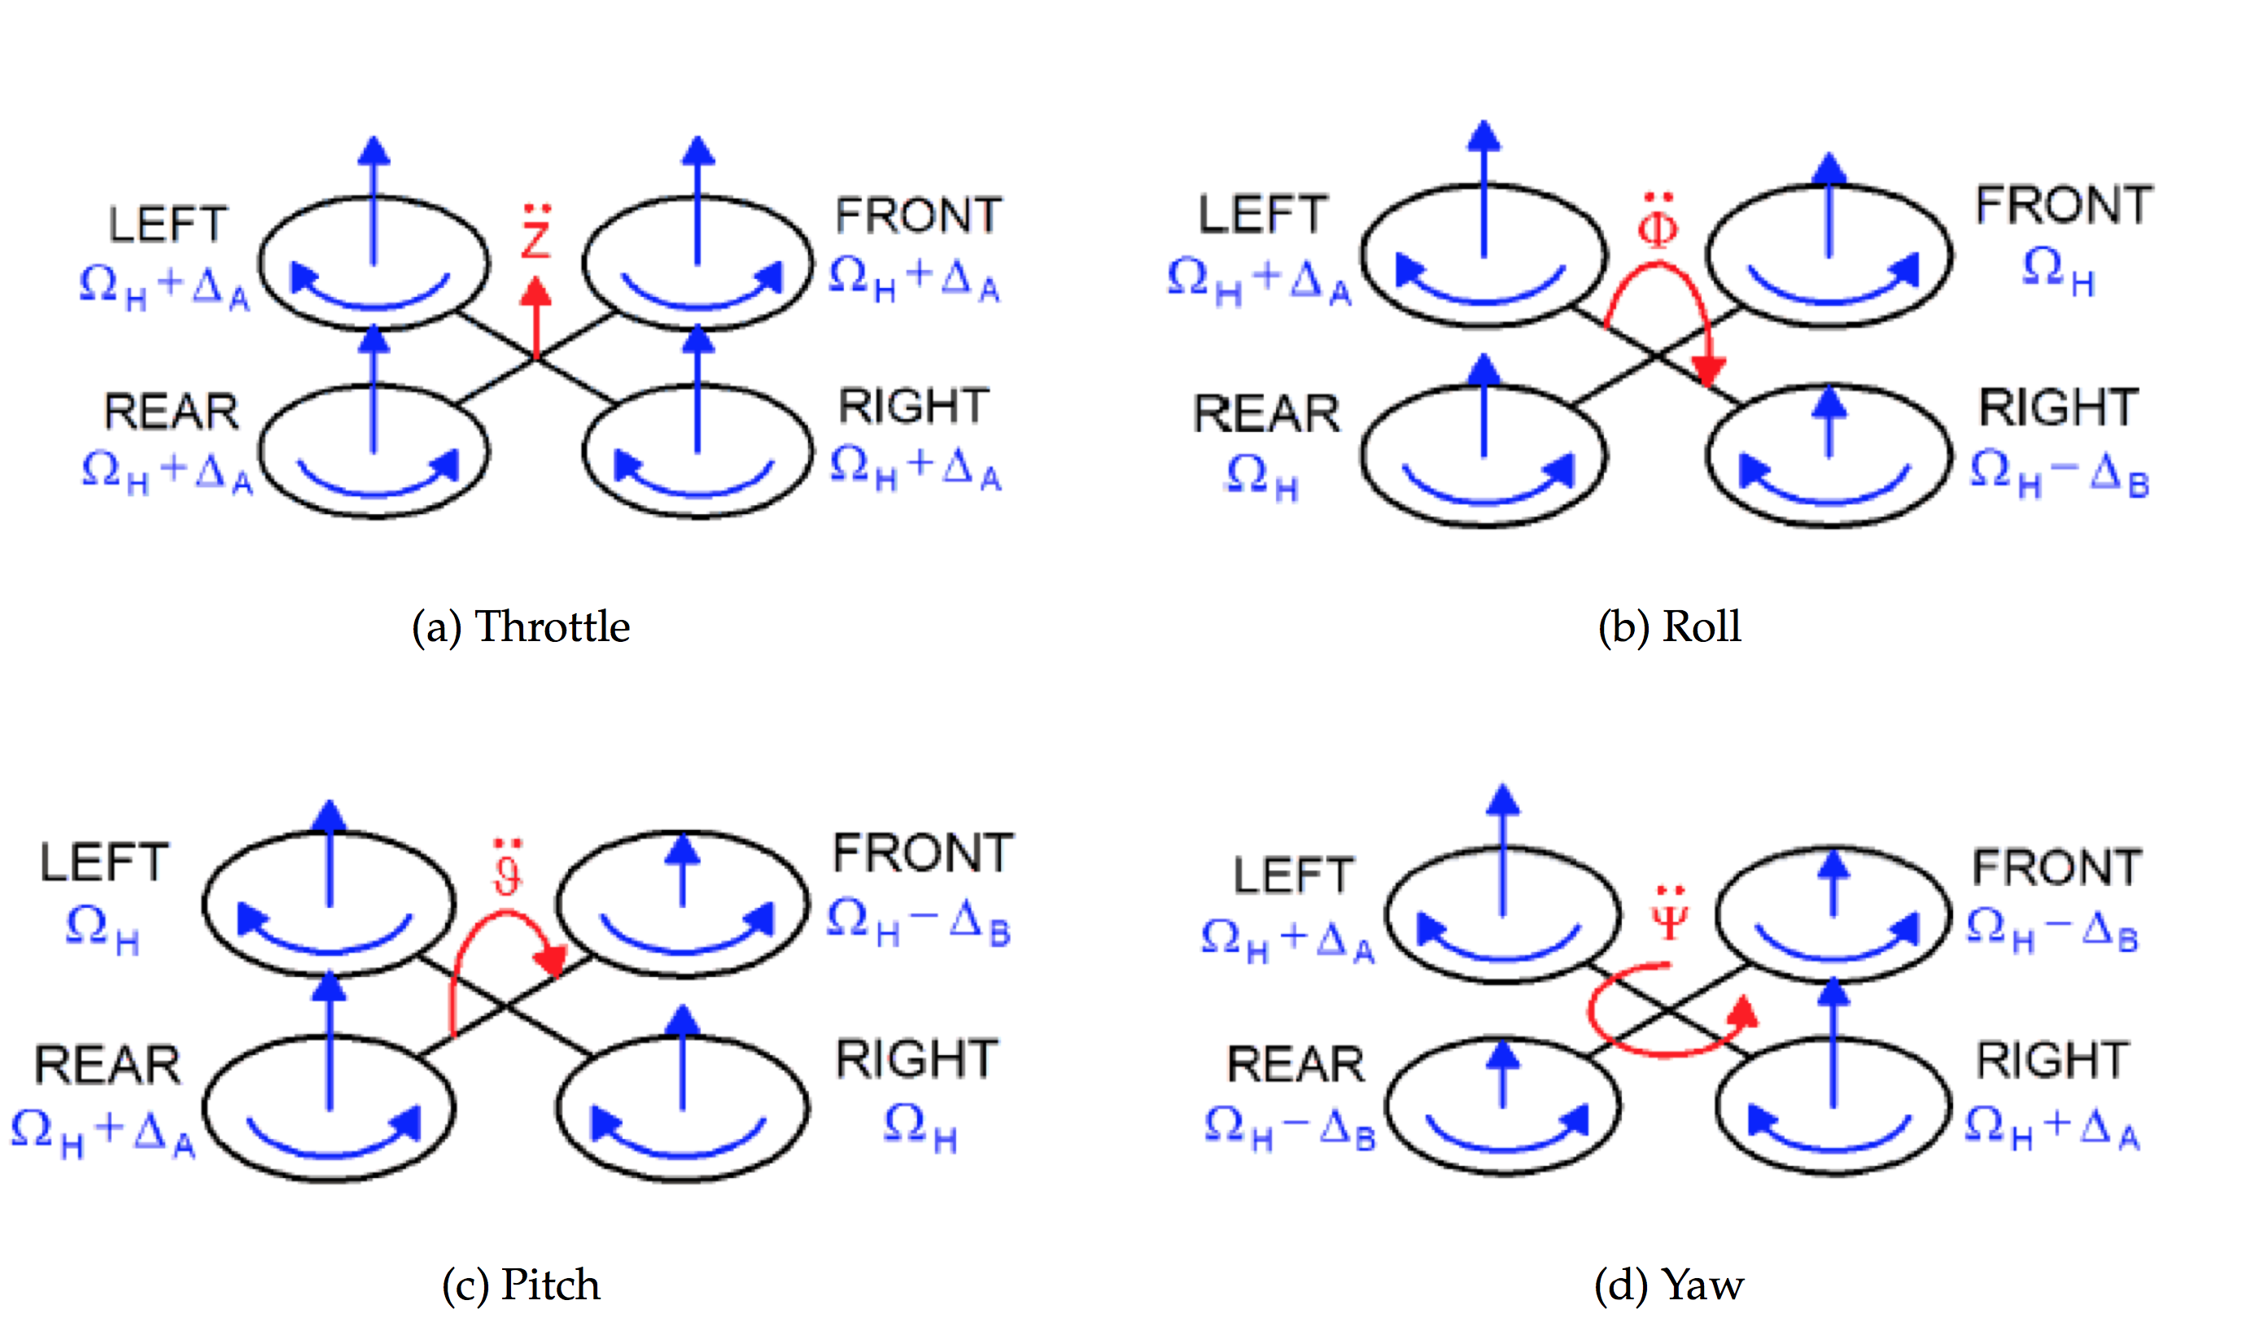
Anatomy of a Quadcopter (Flying Principle)
From https://projects.ardrone.org ARDrone_Developer_Guide.pdf
#DevNexusDrone

Slide 20
Demo: Fly drone with this code for a box pattern...
private static void doDemoFlightBox(A4jBrain brain) {
brain.takeoff().hold(5000);
brain.goRight(20).doFor(1000); // % speed, ms duration
brain.hover().hold(4000);
brain.backward(20).doFor(800);
brain.hover().hold(4000);
brain.goLeft(20).doFor(1500);
brain.hover().hold(4000);
brain.forward(20).doFor(1200);
brain.hover().hold(4000);
brain.land();
}
#DevNexusDrone

Slide 21
Example code for goHome() functionality
private static void doDemoFlightHome (A4jBrain brain) {
brain.takeoff().hold(6000);
brain.forward(20).doFor(400);
brain.hover().hold(2000);
brain.goRight(20).doFor(400);
brain.hover().hold(2000);
brain.forward(20).doFor(400);
...
brain.goHome();
brain.hover().hold(2000);
brain.land();
}
#DevNexusDrone

Slide 22
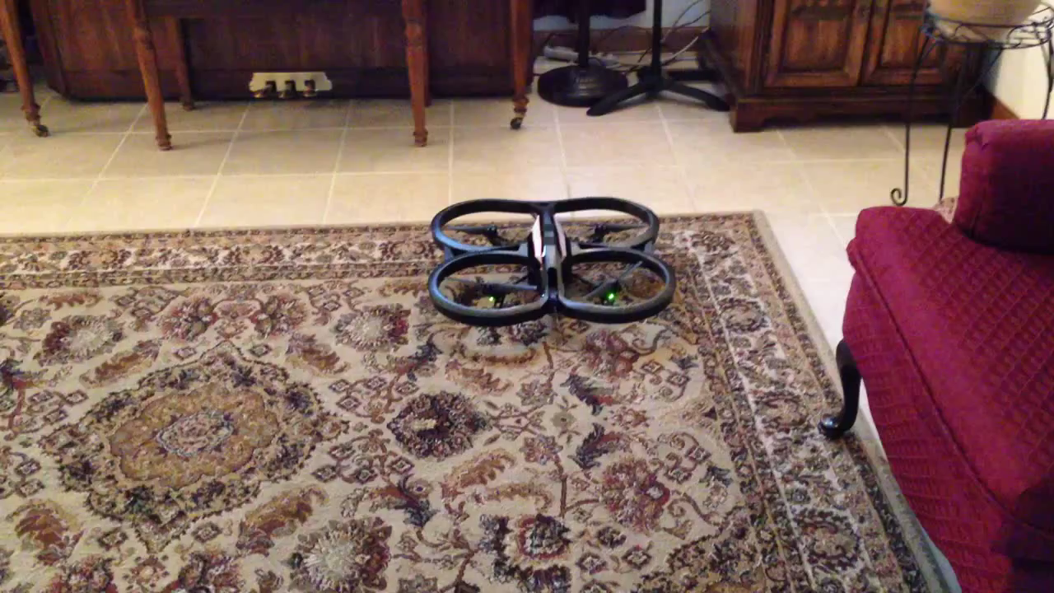
Video: Fly drone and goHome()
#DevNexusDrone

Slide 23
Example code for controlling LEDs
private static void doDemoFlightLeds(A4jBrain brain) {
brain.takeoff().hold(6000);
brain.playLedAnimation(LedAnimation.BLINK_GREEN,
10, 3);
brain.hover().hold(2000);
brain.playLedAnimation(LedAnimation.BLINK_GREEN,
10, 3);
brain.hover().hold(2000);
brain.land();
}
#DevNexusDrone

Slide 24
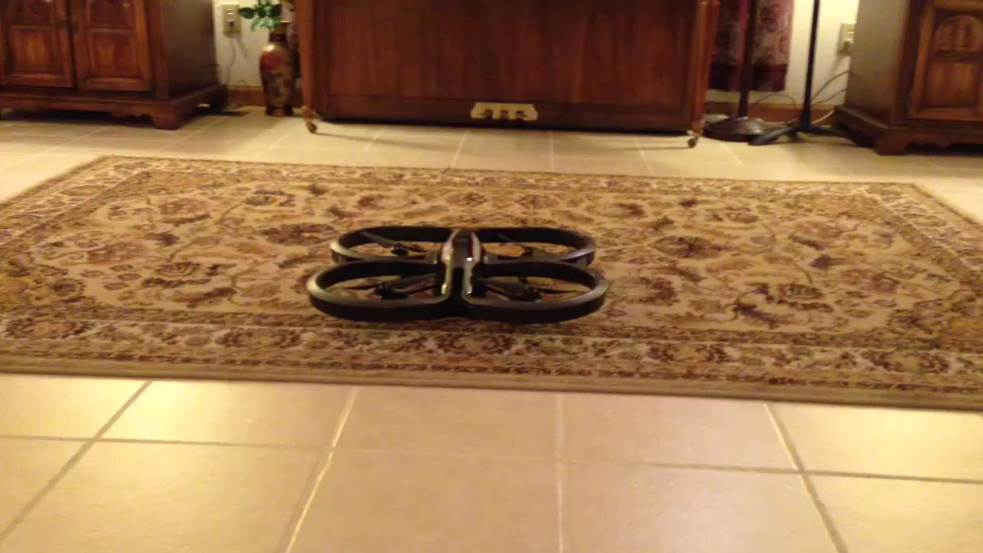
Video: Fly drone and control LEDs
#DevNexusDrone

Slide 25
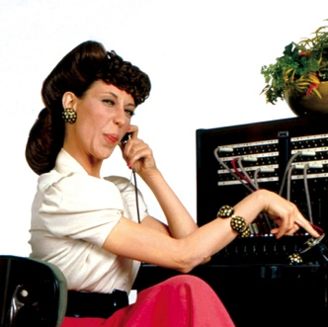

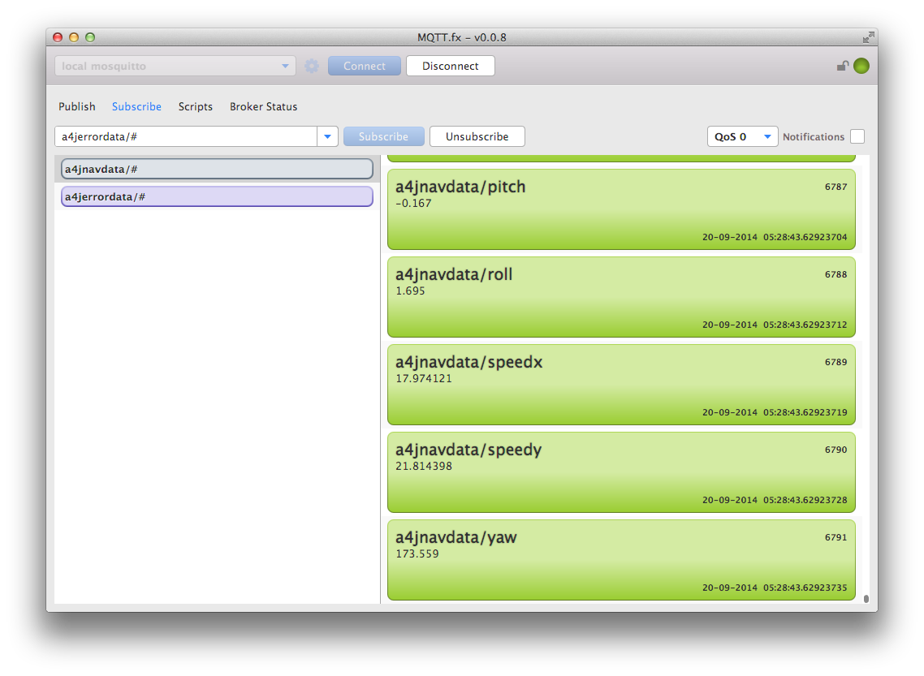


Leveraging IoT Concepts and Tools
#DevNexusDrone

Slide 26
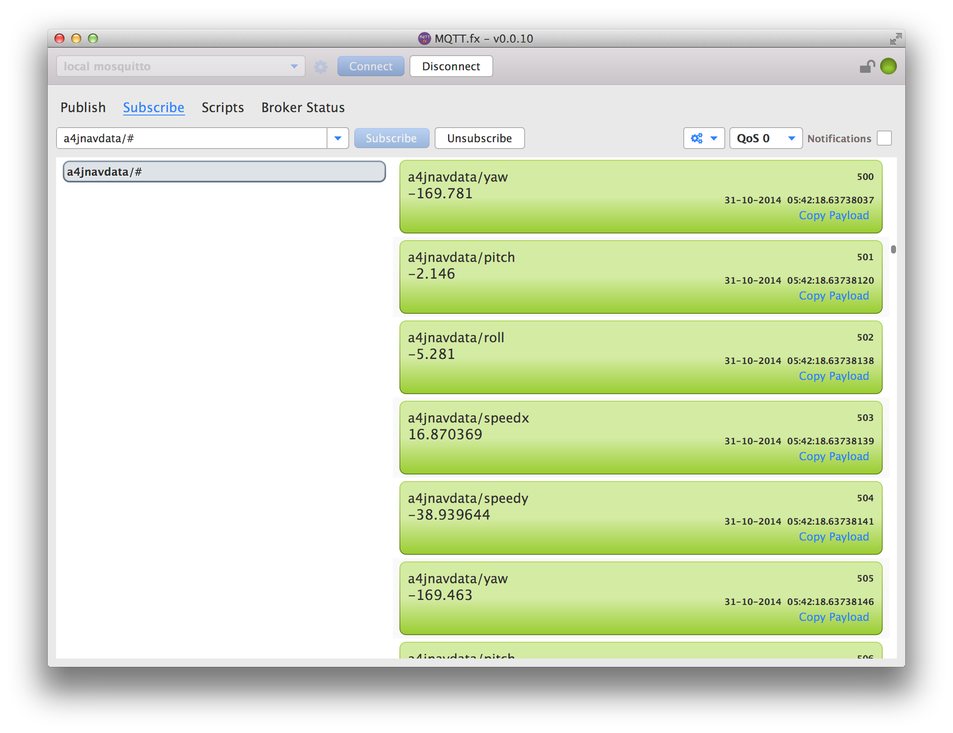
Leveraging IoT Concepts and Tools Thanks to Jens Deters @Jerady for MQTT.fx http://mqttfx.org
Subscribe to flight data
Publish flight data
#DevNexusDrone

Slide 27

Demo: Monitoring drone flight with MQTT.fx Let’s have a look!
#DevNexusDrone

Slide 28

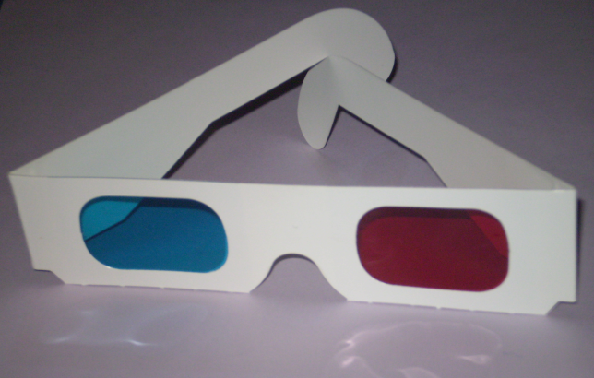
Welcoming our Robot Overlords…
In 3D!!! *
* Skull Faced Alien Space Helmeted Gorilla Suit not included.
#DevNexusDrone

Slide 29

Message from co-presenter Sean Phillips @SeanMiPhillips
#DevNexusDrone

Slide 30

Know your Overlord!!
Loading a Robot Overlord 3D Model
Overlord class is a Group
Load model assests (.obj) within constructor
Leverages Interactive
http://www.interactivemesh.org/models/jfx3dimporter.html
Importer adds object MeshViews as children
All transforms made on the entire group
Overlord has no control smarts only API
#DevNexusDrone

Slide 31
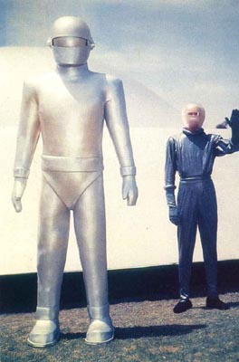
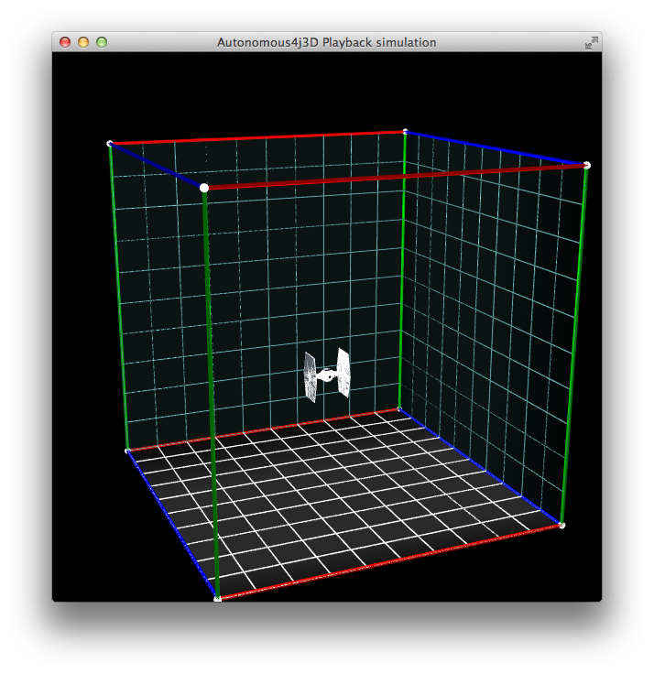
Klaatu barada nikto
Acquiring and Processing Commands
Drag and Drop your .afr Flight Command Log onto the 3D scene.
Function to parse into FlightCommand Object
Add your Overlord like any other object
Task <Void> task = new Task<Void>() {
@Override
protected Void call() throws Exception {
try {
//Read in the playback file:
List<FlightCommand> playback = Files.lines(file.toPath())
.filter(line -> !line.isEmpty())
.map(mapToFlightCommand)
.collect(toList());
Platform.runLater(() -> {
sceneRoot.getChildren().add(overlord);
});
#DevNexusDrone

Slide 32
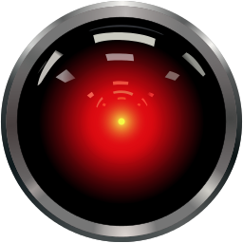
Demo. Pay attention.
#DevNexusDrone

Slide 33
Next Step: Self-aware Drone Implementing a Control Loop
“General Autonomy” vs. “Advanced Autonomy”
Creating an external control loop
Self-adjustment to achieve/maintain goal
Higher-level goals vs. commands
May require change of platform
#DevNexusDrone

Slide 34

Enabling state estimation with an oriented roundel
#DevNexusDrone

Slide 35

State estimation and position control
Desired pose
(x, y, z, yaw)
Measured error
Controller
Control
(rotor speeds)
Drone
Measured pose
(x, y, z, yaw)
Sensors
brain.goRight(20).doFor(1000); // % speed, ms duration
vs.
Pose des = new Pose(3500, 4800, 300, 45); // x, y, z, yaw
brain.moveTo(des);
#DevNexusDrone

Slide 36

In Conclusion…
Thank you for attending
Keep the information flowing
James Weaver (@JavaFXpert)
Mark Heckler (@MkHeck)
Sean Phillips (@SeanMiPhillips)
Any questions?
#DevNexusDrone

Slide 37
Appendix A Parts list: Positronic Brain
Raspberry Pi Model B
Pi case (ex: http://www.amazon.com/gp/product/B008TD1FSQ/)
SD card (ex: http://www.amazon.com/gp/product/B00DX5D9I4/)
Edimax wifi adapters (http://www.amazon.com/Edimax-EW-7811Un-Adapter-Raspberry-Supports/dp/B003MTTJOY/)
Power adapter (ex: http://www.amazon.com/gp/product/B00GWDLJGS/)
USB charger (ex: http://www.amazon.com/gp/product/B00H7TR9WY/)
Ethernet cable
#DevNexusDrone

Slide 38
#DevNexusDrone
Notes:
This is a Safe Harbor Front slide, one of two Safe Harbor Statement slides included in this template.
One of the Safe Harbor slides must be used if your presentation covers material affected by Oracle’s Revenue Recognition Policy
To learn more about this policy, e-mail: Revrec-americasiebc_us@oracle.com
For internal communication, Safe Harbor Statements are not required. However, there is an applicable disclaimer (Exhibit E) that should be used, found in the Oracle Revenue Recognition Policy for Future Product Communications. Copy and paste this link into a web browser, to find out more information.
http://my.oracle.com/site/fin/gfo/GlobalProcesses/cnt452504.pdf
For all external communications such as press release, roadmaps, PowerPoint presentations, Safe Harbor Statements are required. You can refer to the link mentioned above to find out additional information/disclaimers required depending on your audience.

Slide 39
Creating Our Robot Overlords
Autonomous Drone Development with Java and IoT
#DevNexusDrone
James Weaver / Mark Heckler
Java Ambassador / Software Engineer
Oracle
Sean Phillips
Software Engineer
Ai Solutions
Copyright © 2014, Oracle and/or its affiliates. All rights reserved. |

